Slide 1
Project Phase 1a Concept: Blast Force
By: Jordan Arevalos, Todd St. Onge, Jinyang Dong, Abdul Al-Sabri, Alsalt Al-Fahdi, Homero Garza
Date: 1/30/2020

Slide 2
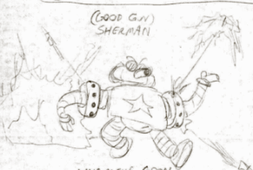
Concept
“Blast Force” is a fast-paced 3D platformer, using rocket jumping mechanics to explore and traverse various areas, grabbing the key object, then racing back to the start against a timer.
Key mechanics is 360 degree firing of rockets while platforming to get through enemies, obstacles, or fire yourself to go faster or platform
The story is about a walking tank named Sherman and his treasure hunting adventures to find the legendary Chekov’s Firing Pin

Slide 3

Target Audience
Our preferred ESRB rating is E 10+ due to comic mischief and themes of the game, our target audience is everyone above the age 10.

Slide 4
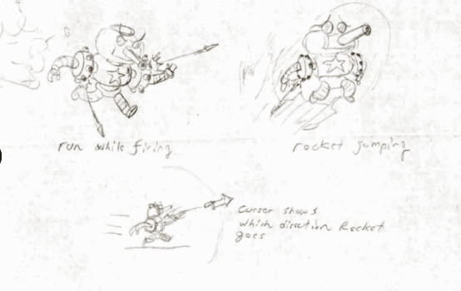
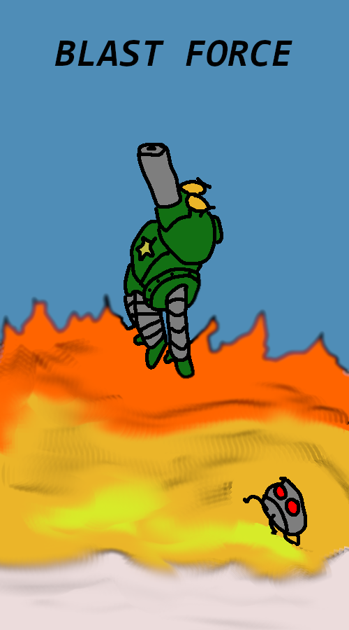
Cover/Concept Designs
Target ESRB Rating: E 10+

Slide 5
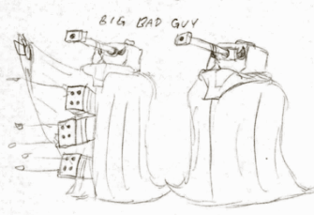
Hardware/Software
Platform: PC mainly - with the expectation to implement it on console.
Game Engine: Unity.
Programming Language: C#
2D Art Assets: https://www.piskelapp.com/

Slide 6
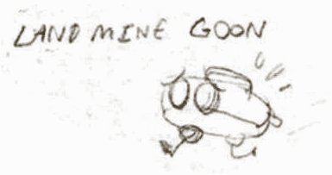
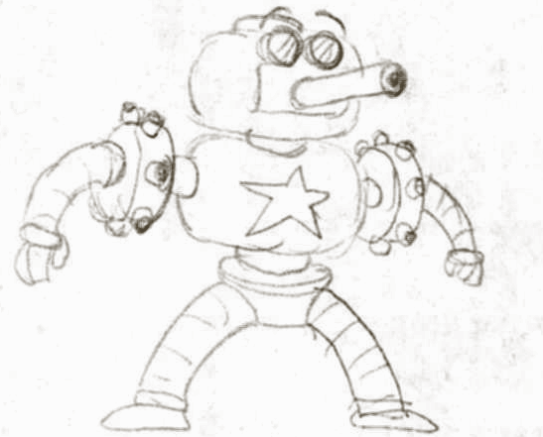
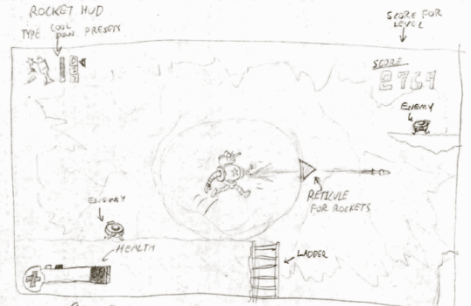
Project Style and Focus
Currently “Blast Force” is going to be setting its focus on art design and programming the gameplay mechanics.

Slide 7
Project Schedule (Tenative)
Month | January | February | March | April | May
Objective / Week | 1 | 2 | 3 | 4 | 5 | 6 | 7 | 8 | 9 | 10 | 11 | 12 | 13 | 14 | 15 | 16 | 17
Concept
Requirements and Design
Implementation
Testing
Integration - Showcase

Slide 8
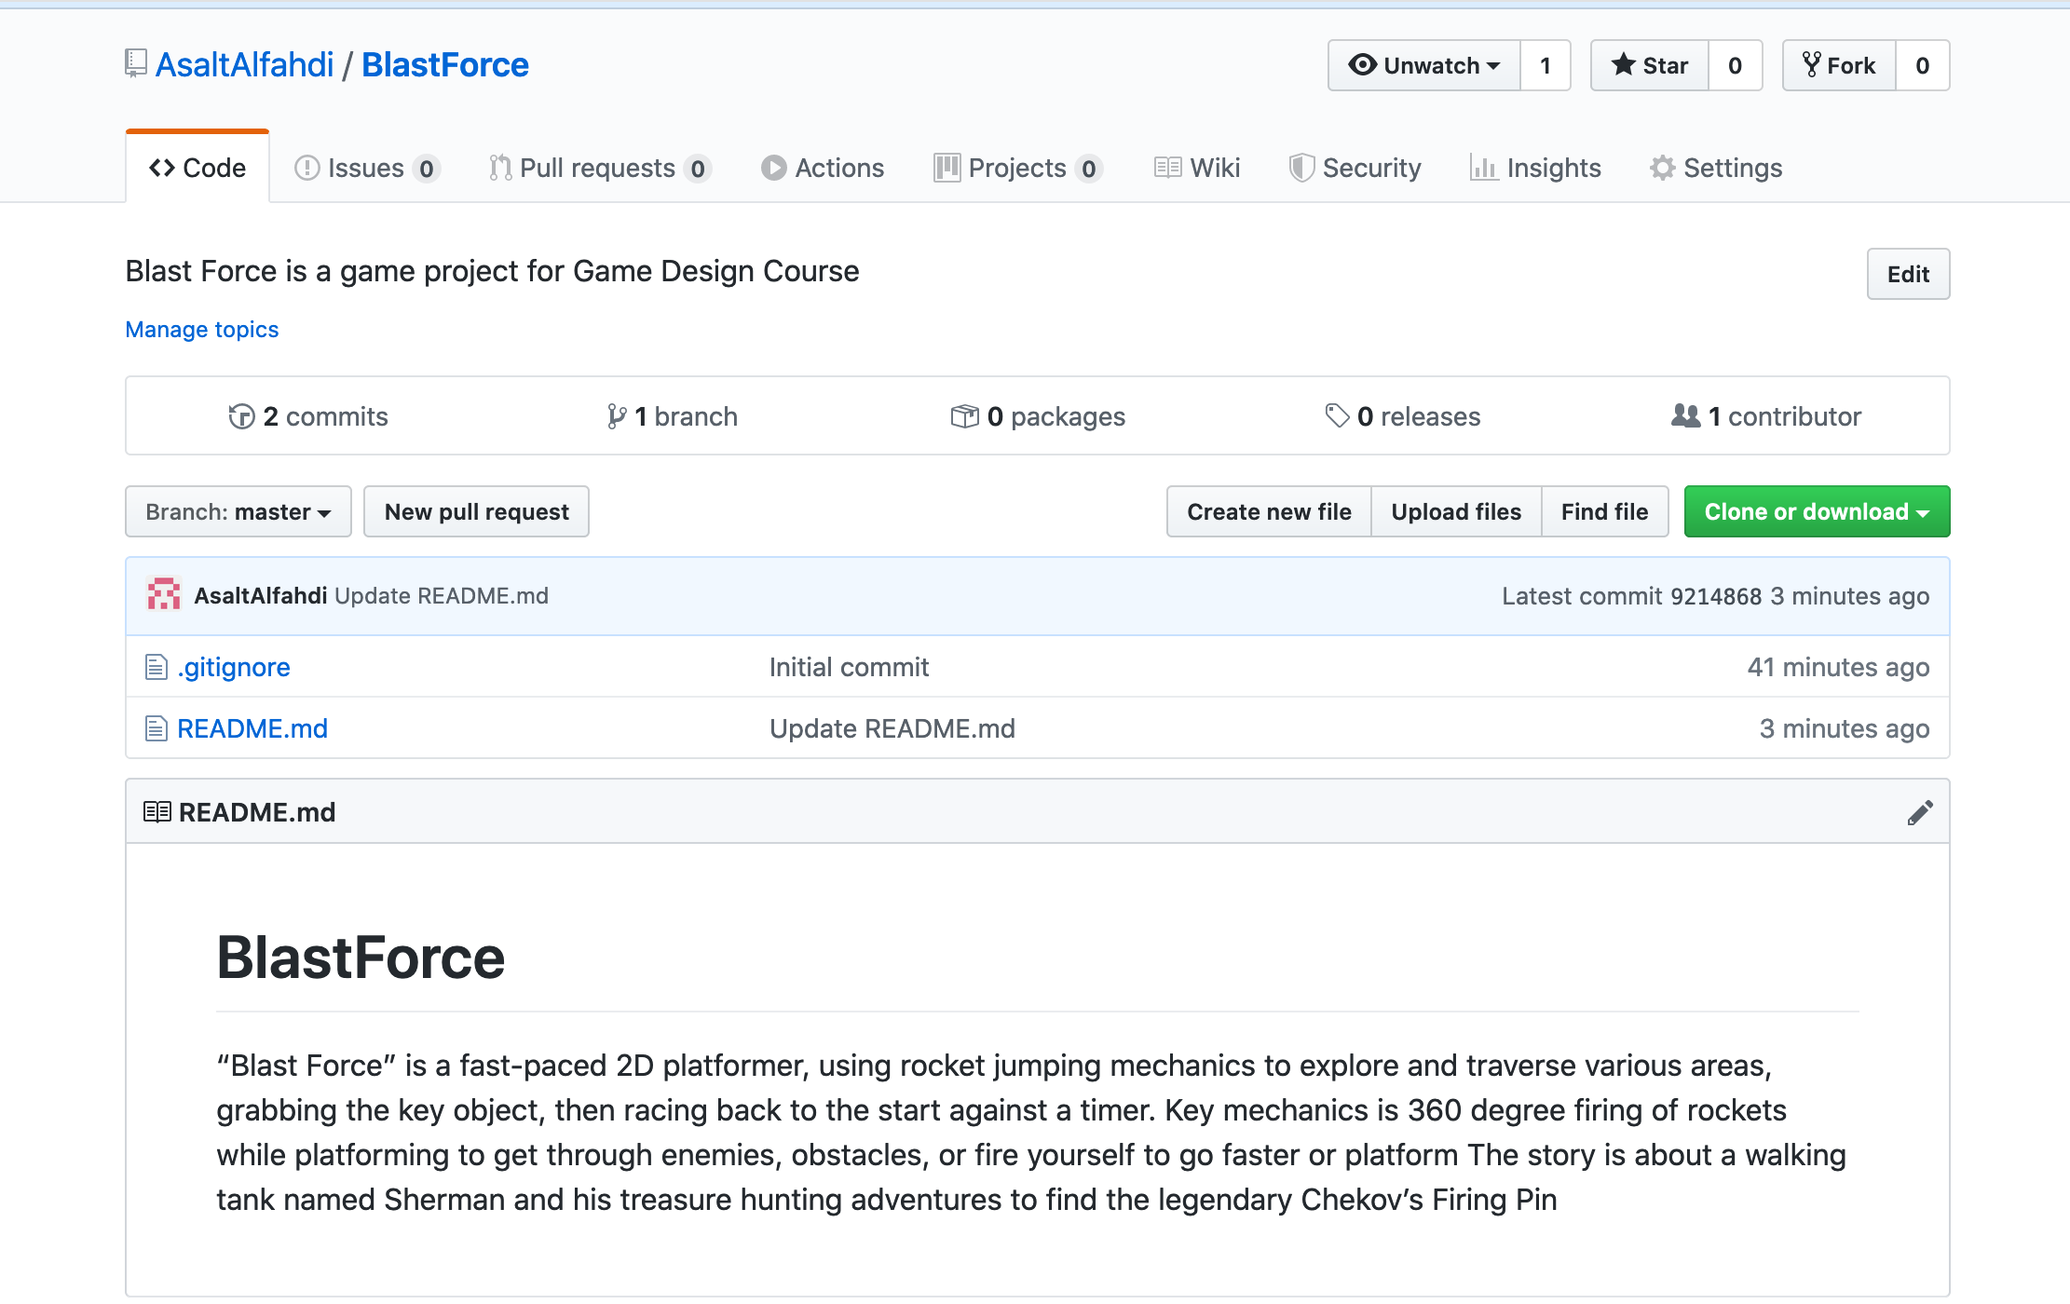
Snapshot of CM Repository

Slide 9
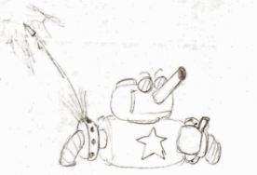
Questions?

